Slide 1
Fall 2020
DATS 501 Fundamentals of Data Science
Hasan Demirtaş
hdemirtas.academic@gmail.com

Slide 2
Unsupervised vs Supervised

Slide 3
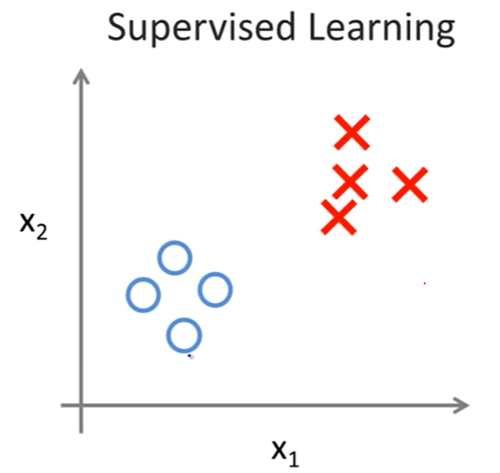
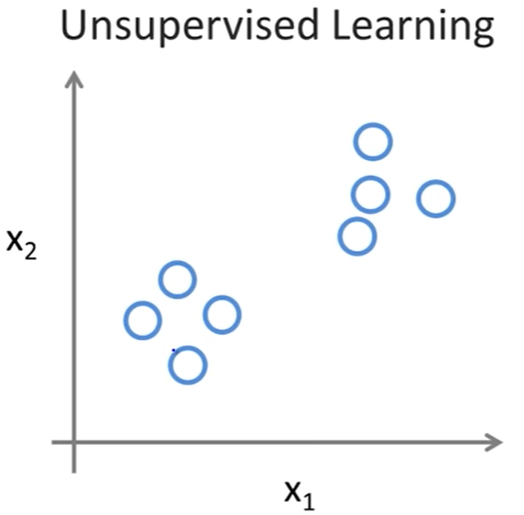
Supervised vs Unsupervised
Labeled data
There is no label
What to do when there is no labels?

Slide 4
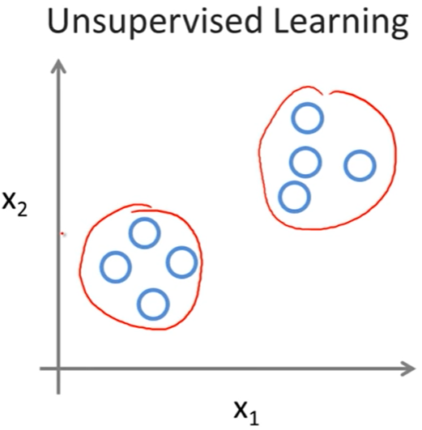
Unsupervised Learning
Answer: Grouping

Slide 5
Unsupervised Learning – Clustering Concept
Clustering:
Groups data regarding similarity / dissimilarity
Flat clustering and hierachical clustering are two major types
Distance based versions are popular and k-means is the most popular one among clustering algorithms

Slide 6
Unsupervised Learning – 3 Major Types
Centroid algorithms (partioning - flat)
Usually start with a random (partial) partitioning
Refine it iteratively
K-means clustering is the most popular one
Density algorithms
Dense regions are clustered
DBSCAN is the most popular one
Hierarchical algorithms
Bottom-up, agglomerative
(Top-down, divisive)

Slide 7
Unsupervised Learning – Clustering Concept
Hard clustering
Each document belongs to exactly one cluster
More common and easier to do
Soft clustering
Makes more sense for applications like creating browsable hierarchies
You may want to put a pair of sneakers in two clusters: (i) sports apparel and (ii) shoes
We will cover hard clustering

Slide 8
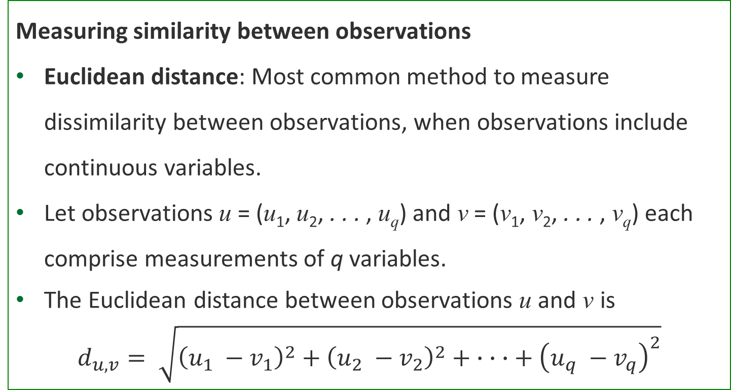
Unsupervised Learning – Distance metric
Measuring similarity between observations
Euclidean distance: Most common method to measure dissimilarity between observations, when observations include continuous variables.
Let observations u = (u₁, u₂, . . . , u_{q}) and v = (v₁, v₂, . . . , v_{q}) each comprise measurements of q variables.
The Euclidean distance between observations u and v is
$$d_{u, v}= \sqrt{{\left(u_{1} −v_{1}\right)}^{2}+{\left(u_{2} −v_{2}\right)}^{2}+ ∙ ∙ ∙+ {\left(u_{q} −v_{q}\right)}^{2}}$$

Slide 9
Unsupervised Learning – An example
Measuring similarity between observations
Illustration:
KTC is a financial advising company that provides personalized financial advice to its clients.
KTC would like to segment its customers into several groups (or clusters) so that
The customers within a group are similar and dissimilar with respect to key characteristics

Slide 10
Unsupervised Learning – An example
Measuring similarity between observations
Illustration (contd.):
For each customer, KTC has corresponding to a vector of measurements on seven customer variables, that is, (Age, Female, Income, Married, Children, Car Loan, Mortgage).
Example: The observation u = (61, 0, 57881, 1, 2, 0, 0) corresponds to a 61-year-old male with an annual income of $57,881, married with two children, but no car loan and no mortgage.

Slide 11
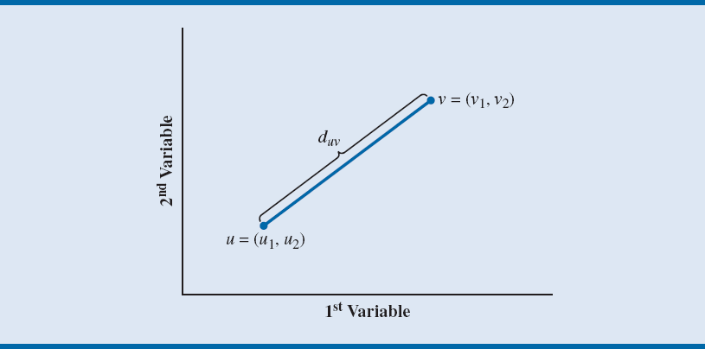
Unsupervised Learning – An example
Euclidean distance becomes smaller as a pair of observations become more similar with respect to their variable values.
Notes:
Figure 6.1 depicts Euclidean distance for two observations consisting of two variable measurements.
Euclidean distance is highly influenced by the scale on which variables are measured.
Therefore, it is common to standardize the units of each variable j of each observation u;
Example: u_{j}, the value of variable j in observation u, is replaced with its z-score, z_{j}.
The conversion to z-scores also makes it easier to identify outlier measurements, which
can distort the Euclidean distance between observations.

Slide 12
Unsupervised Learning – Distance Metric
Euclidean distance is highly influenced by the scale on which variables are measured.
Therefore, it is common to standardize the units of each variable j of each observation u;
Example: u_{j}, the value of variable j in observation u, is replaced with its z-score, z_{j}.
The conversion to z-scores also makes it easier to identify outlier measurements, which can distort the Euclidean distance between observations.

Slide 13
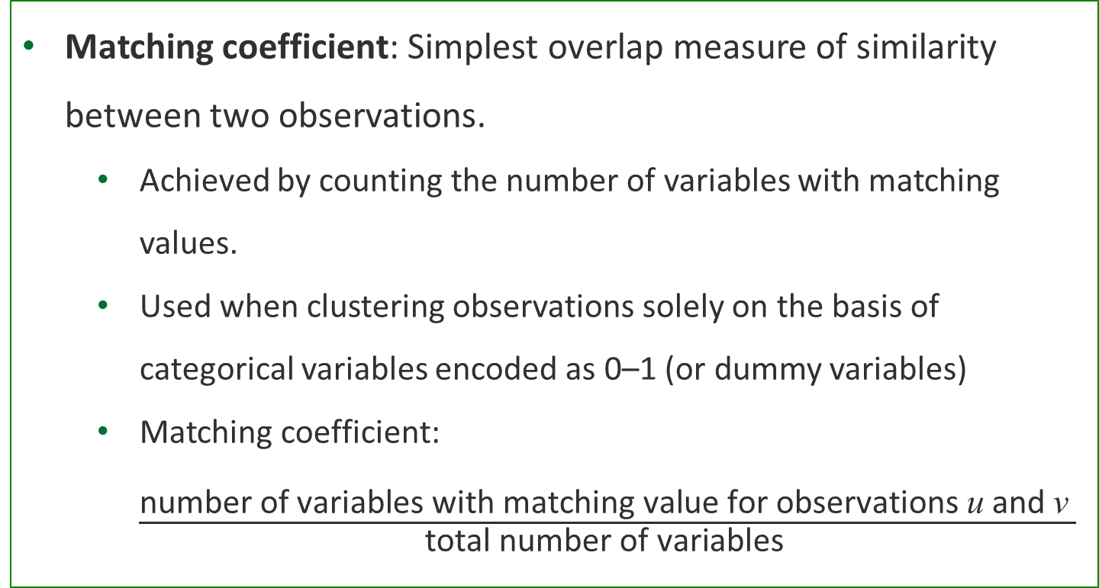
Unsupervised Learning – Distance Metric
Matching coefficient: Simplest overlap measure of similarity between two observations.
Achieved by counting the number of variables with matching values.
Used when clustering observations solely on the basis of categorical variables encoded as 0–1 (or dummy variables)
Matching coefficient: $\frac{\text{number} \text{of} \text{variables} \text{with} \text{matching} \text{value} \text{for} \text{observations} \text{u} \text{and} \text{v} }{\text{total} \text{number} \text{of} \text{variables} }$

Slide 14
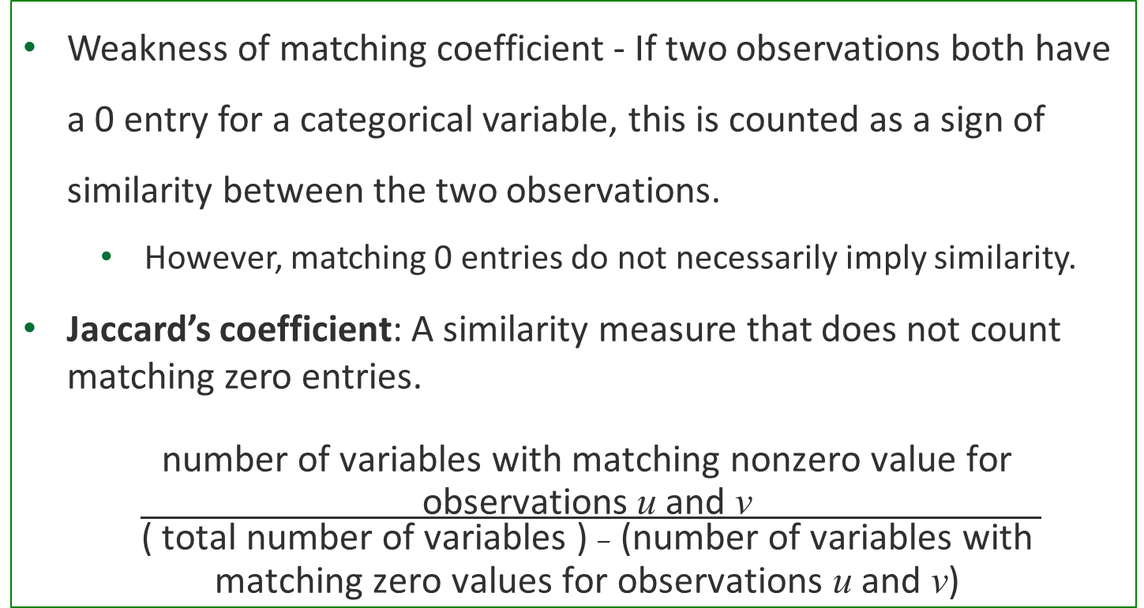
Unsupervised Learning – Distance Metric
Weakness of matching coefficient - If two observations both have a 0 entry for a categorical variable, this is counted as a sign of similarity between the two observations.
However, matching 0 entries do not necessarily imply similarity.
Jaccard’s coefficient: A similarity measure that does not count matching zero entries.
$\frac{\begin{aligned}\text{number} \text{of} \text{variables} \text{with} \text{matching} \text{nonzero} \text{value} \text{for} \\ \text{observations} \text{u} \text{and} \text{v} \end{aligned}}{\begin{aligned}\text{( }\text{total} \text{number} \text{of} \text{variables}\text{ ) }–\text{ (}\text{number} \text{of} \text{variables} \text{with} \\ \text{matching} \text{zero} \text{values} \text{for} \text{observations} \text{u} \text{and} \text{v}\text{) }\end{aligned}}$

Slide 15
Unsupervised Learning – Clustering Methods

Slide 16
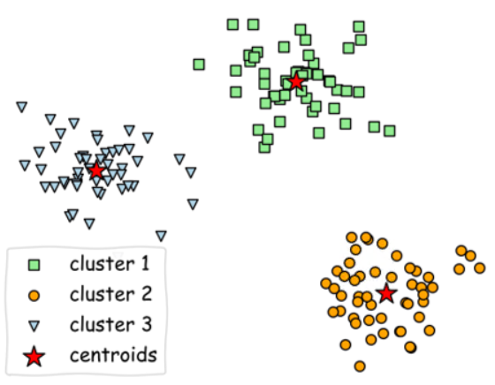
Centroid algorithms
General concept

Slide 17
Centroid algorithms
K-means working method
K number is given by human to tell the algorithm how many clusters will be created
K can be found by trying different K values and getting best performing K according to
The Elbow Method: Total distance of data points to cluster center
The Silhouette Method: Belonging rating of data points between -1 and 1 to a cluster compared to other clusters
An initial p1 is placed in the space
Another p2 point is placed a far opposite place compared to p2. Then p3 point is placed far away from p1 and p2
Points p4 .... pK are placed in the space in this manner

Slide 18
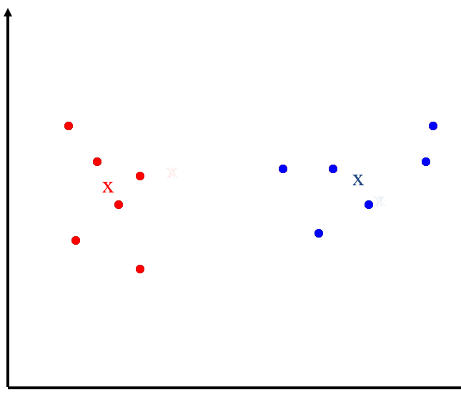
Centroid algorithms
K-means working method cont. – 2 clusters example
Pick cluster centers
Assign data points to centers
Compute the new centers
Assing data points to new centers
Converged ☺

Slide 19
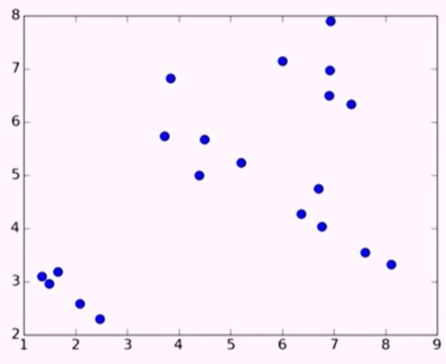
Centroid algorithms
K-means working method cont. – 4 clusters example
Generated data

Slide 20
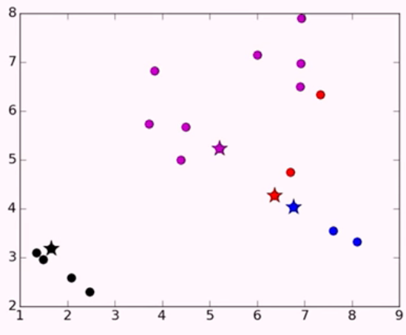
Centroid algorithms
K-means working method cont. – 4 clusters example
Randomly chosen initial points are added
Classes are assigned to them

Slide 21
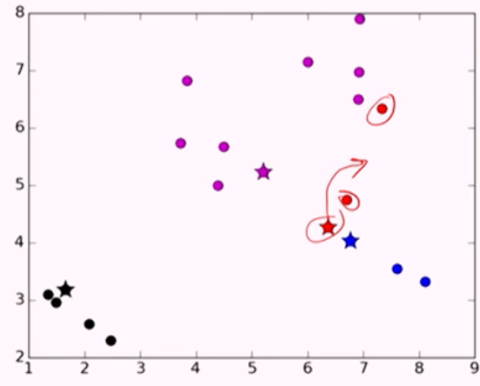
Centroid algorithms
K-means working method cont. – 4 clusters example
Iteration 1: centroid move

Slide 22
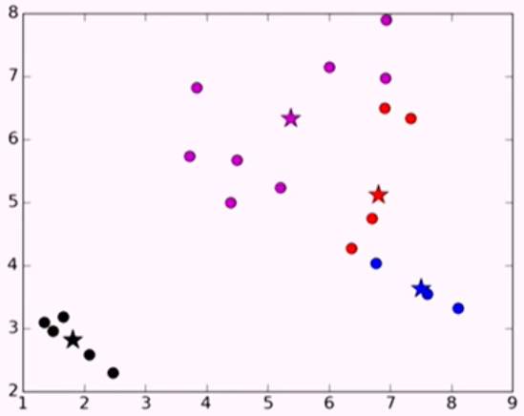
Centroid algorithms
K-means working method cont. – 4 clusters example
Iteration 1: final form

Slide 23
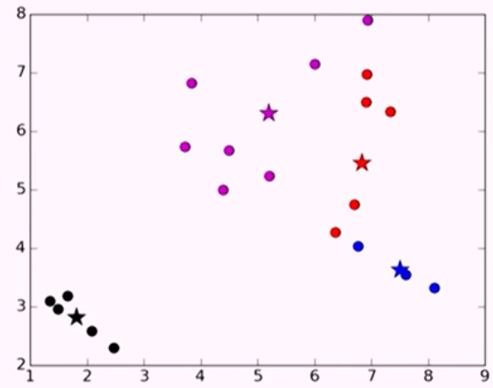
Centroid algorithms
K-means working method cont. – 4 clusters example
Iteration 2

Slide 24
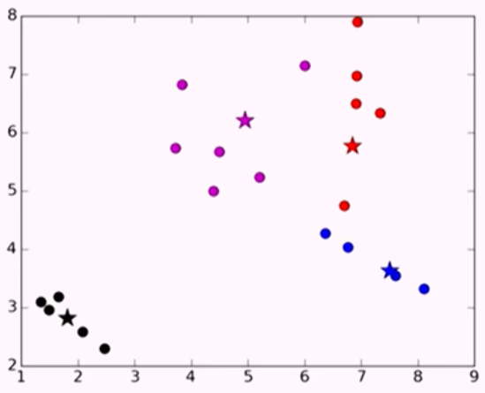
Centroid algorithms
K-means working method cont. – 4 clusters example
Iteration 3

Slide 25
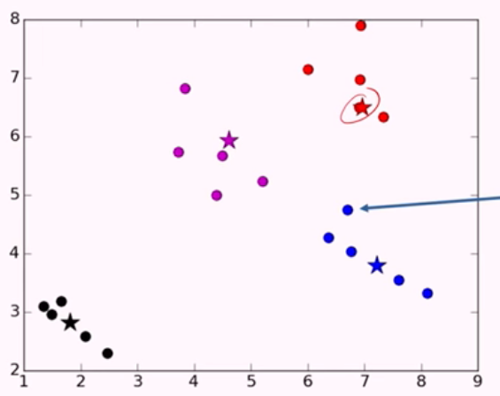
Centroid algorithms
K-means working method cont. – 4 clusters example
Iteration 4

Slide 26
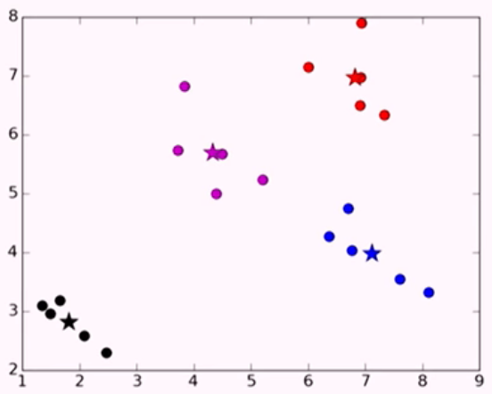
Centroid algorithms
K-means working method cont. – 4 clusters example
Iteration 5

Slide 27
Centroid algorithms
K-means iterations and convergence
K-means is a special case of a general procedure known as the Expectation Maximization (EM) algorithm. EM is claimed to be known as an algorithm that converge
The error is monotonically decreasing
Practically it converges fast

Slide 28
Centroid algorithms
Outliers in K-means
It does not have any features to handle outliers
K-means utilizes features numerically
Features are used as numeric meaning they needed to be scaled regarding their importance before usage

Slide 29
Centroid algorithms
K-means outlier solution?
K-medoids
Uses medoids ( a real data point instead of centroid ) for cluster centers.
When an outlier tries to deviate clusters from grouped data and there is no data close to that center, the data center is chosen from closest actual data point

Slide 30
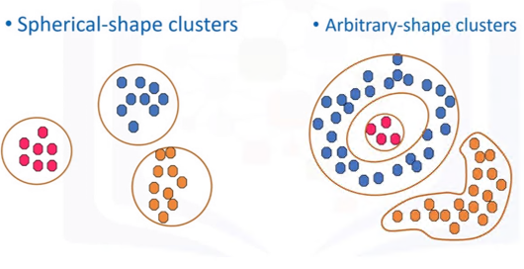
Density algorithms
DBSCAN
Centroid based algorithms cannot detect clusters which are not gathered regarding distance

Slide 31
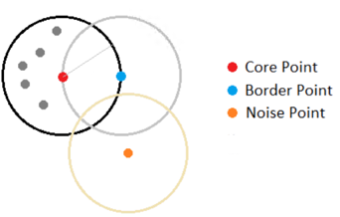
Density algorithms
DBSCAN
Data points close to each other are accepted as a group for density based algorithms

Slide 32
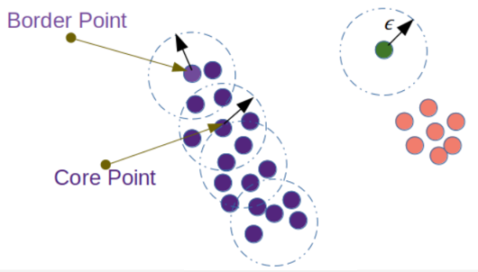
Density algorithms
DBSCAN

Slide 33
Density algorithms
DBSCAN
In an epsilon distance, the algorithm checks number of points that are near a point
If the number of neighbor data points are above a threshold (manually given) that point is accepted as a core point
Border points are close to core points, however they do not have enough neighbors
Core points and border points form a cluster together
The points which can not form a core point alone or close to a core point are accepted as noise

Slide 34
Connectivity based algorithms
Hierarchical clustering: Bottom-up approach
Determines the similarity of two clusters by considering the similarity between the observations composing either cluster.
Starts with each observation in its own cluster and then iteratively combines the two clusters that are the most similar into a single cluster.

Slide 35
Connectivity based algorithms
Hierarchical clustering: It has two types
Agglomerative: This is a "bottom-up" approach: each observation starts in its own cluster, and pairs of clusters are merged as one moves up the hierarchy
Divisive: This is a "top-down" approach: all observations start in one cluster, and splits are performed recursively as one moves down the hierarchy.

Slide 36
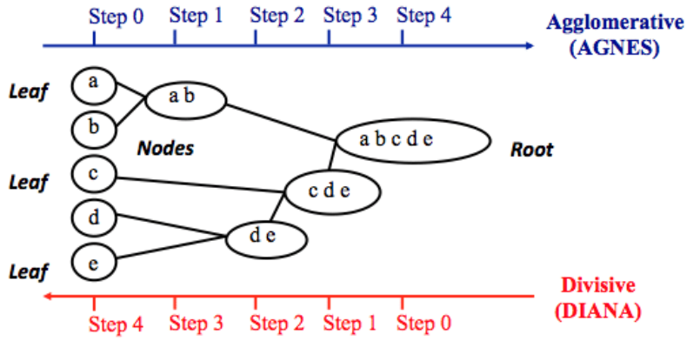
Connectivity based algorithms

Slide 37
Connectivity based algorithms
Methods to obtain a cluster similarity measure:
Single linkage
The similarity between two clusters is defined by the similarity of the pair of observations (one from each cluster) that are the most similar.
Complete linkage
This clustering method defines the similarity between two clusters as the similarity of the pair of observations (one from each cluster) that are the most different.
Average linkage
Defines the similarity between two clusters to be the average similarity computed over all pairs of observations between the two clusters.

Slide 38
Connectivity based algorithms
Methods to obtain a cluster similarity measure:(contd.)
Average group linkage
The similarity between two clusters is defined by the similarity of the pair of observations (one from each cluster) that are the most similar.
Ward’s method
Computes dissimilarity as the sum of the squared differences in similarity between each individual observation in the union of the two clusters and the centroid of the resulting merged cluster.

Slide 39
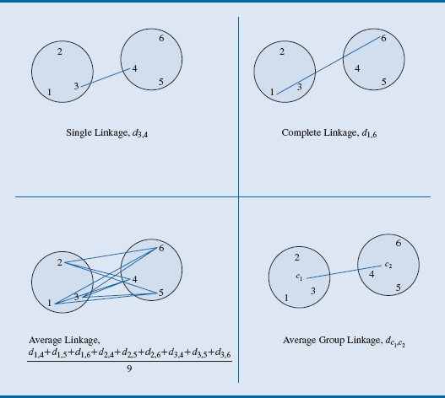
Connectivity based algorithms

Slide 40
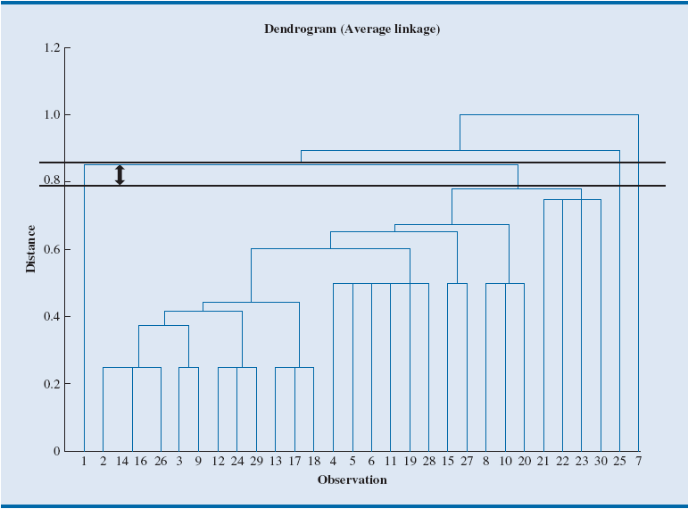
Connectivity based algorithms
A dendrogram is a chart that depicts the set of nested clusters resulting at each step of aggregation.

Slide 41
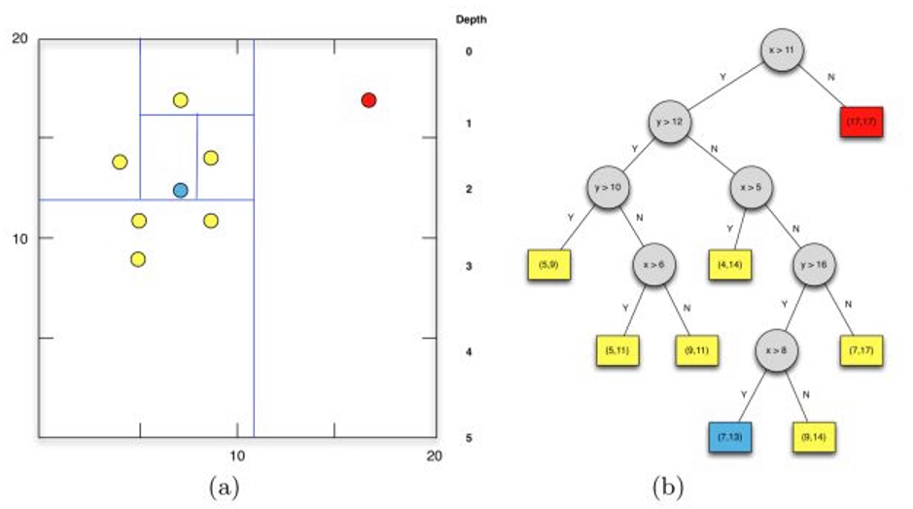
A bonus: Isolation Forest
Isolation forest is an unsupervised learning algorithm for anomaly detection that works on the principle of isolating anomalies, instead of the most common techniques of profiling normal points.

